Slide 1
5. [Lab2] Implementing APIs
Training Workshop for IONIC framework

Slide 2
Objectives
Understand the structure of Express project.
Learn how to use Node.js for creating API.
Learn how to load static image file from server.

Slide 3
Contents
5.1 API
5.2 Creating API with node.js and
express.js
5.2.1 Structure of Express project
5.2.2 Implementing museum API

Slide 4
5.1 API
Listing APIs
APIs are created based on the data each page of application needs.
The museum API will be used for retrieving the URL of museum image and the museum description that are the contents of the About-museum page.

Slide 5
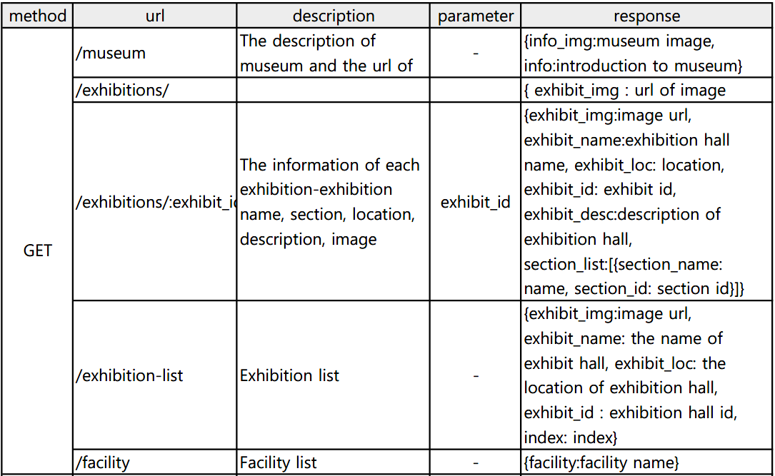

5.1 API

Slide 6
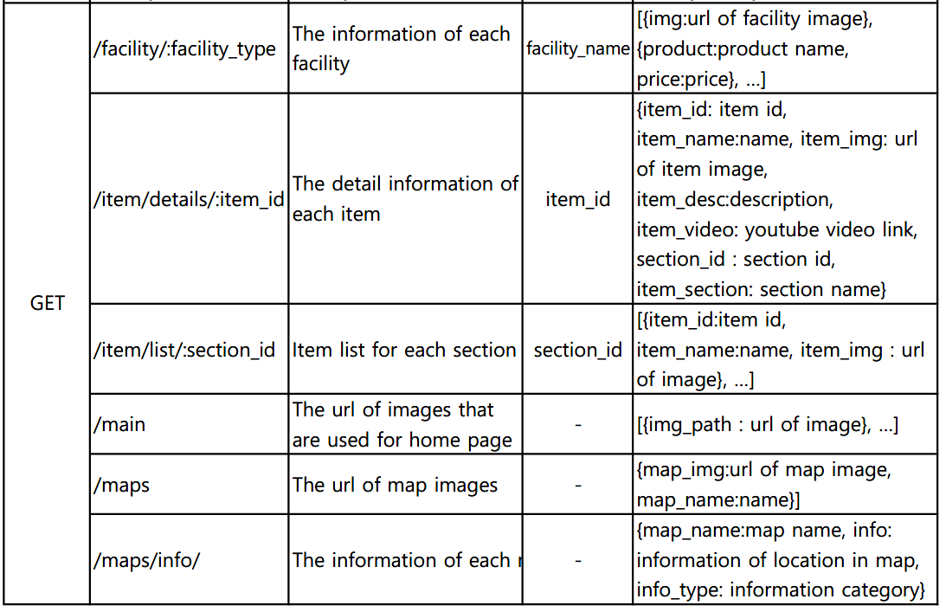
5.1 API

Slide 7
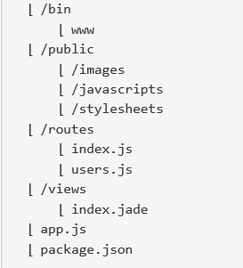
5.2 Creating API with Node.js and Express.js
5.2.1 Structure of Express project
In this section, express project that we generated in chapter 3 will be used.
C:\desktop\server\example
When you generate the express project, you can see the structure in your folder.
source: http://webframeworks.kr/getstarted/expressjs/

Slide 8
5.2 Creating API with Node.js and Express.js
5.2.1 Structure of Express project
app.js
The main file of the application that includes server configuration, middleware definition, route definition, etc., and various logic for server operation.
It consists of three part:
Declaration of module
Setting
Middleware
source: http://webframeworks.kr/getstarted/expressjs/

Slide 9
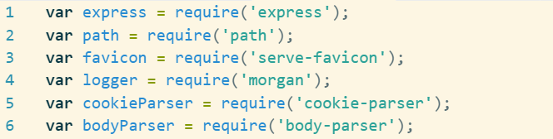
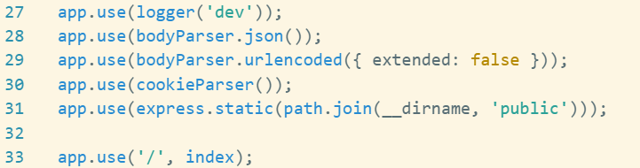
5.2 Creating API with Node.js and Express.js
Implementing museum API
app.js
require() is used for all modules which have dependency.
app.use() is for setting routing
app.js

Slide 10
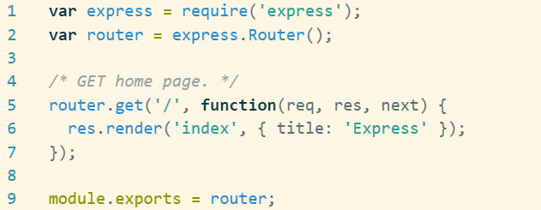
5.2 Creating API with Node.js and Express.js
Implementing museum API
2. /public
A folder for static files that contain JavaScript files, image files, style sheets, and so on.
3. /routes
We create modules for each routing resource to implement routing logic in each file.
/routes/index.js

Slide 11

5.2 Creating API with Node.js and Express.js
Implementing museum API
4. /bin/www
The code for running the server is written(Ex. port number). The app.js file that contains the Express Server configuration code is imported and linked with the HTTP object of the node.
/bin/www

Slide 12
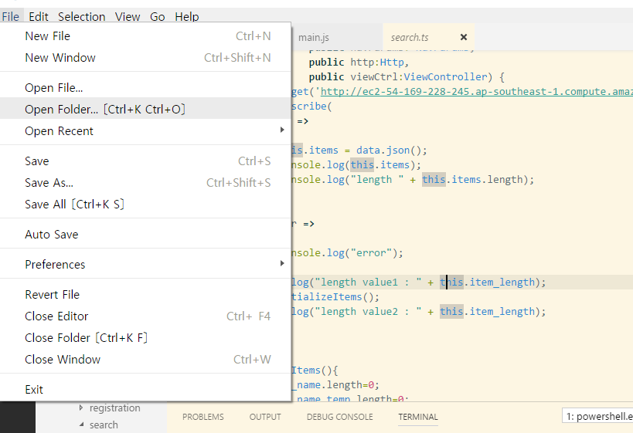
5.2 Creating API with Node.js and Express.js
Implementing museum API
Follow these steps.
Open the example folder on visual studio code.
C:\desktop\server\example

Slide 13
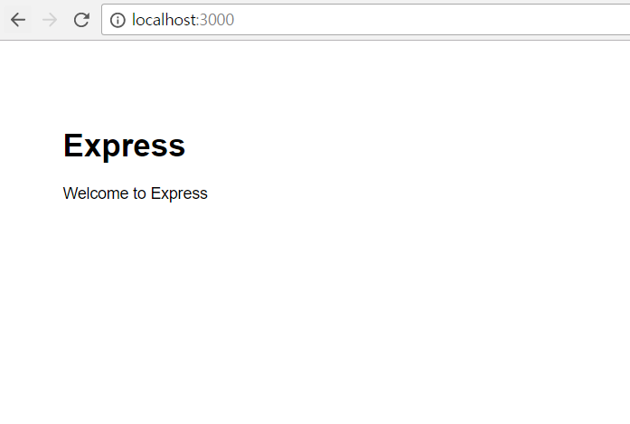
5.2 Creating API with Node.js and Express.js
Implementing museum API
Run command npm start, and access http://localhost:3000 then the screen shows:

Slide 14
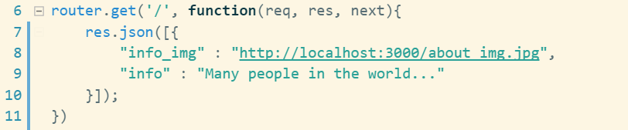
5.2 Creating API with Node.js and Express.js
Implementing museum API
Add museum.js file into routes folder.
Implement museum API with using get() function of router.
res.json() responses with JSON object.
routes/museum.js

Slide 15
5.2 Creating API with Node.js and Express.js
Implementing museum API
Set routing.
app.js

Slide 16
5.2 Creating API with Node.js and Express.js
Implementing museum API
To load image from server with /public url, follow these steps.
Add image file into public/images folder.
Add following code in app.js.
Terminate server with ctrl+c and restart with command npm start.
app.js

Slide 17
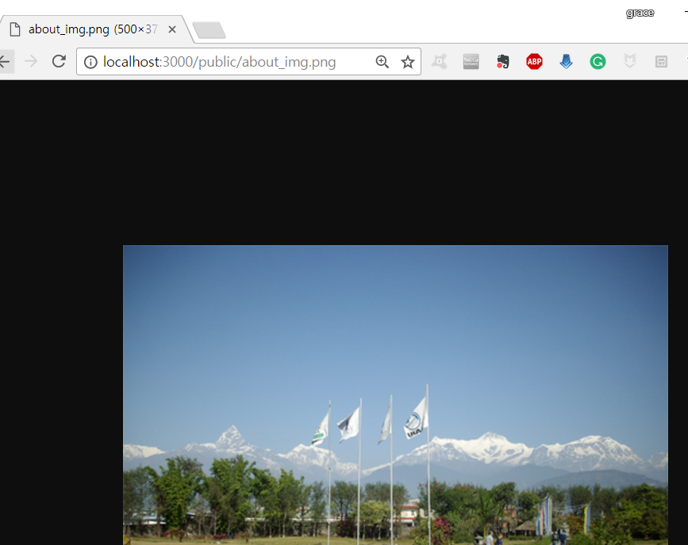
5.2 Creating API with Node.js and Express.js
Implementing museum API
Access localhost:3000/public/[name of image file].
Ex) localhost:3000/public/about_img.png

Slide 18
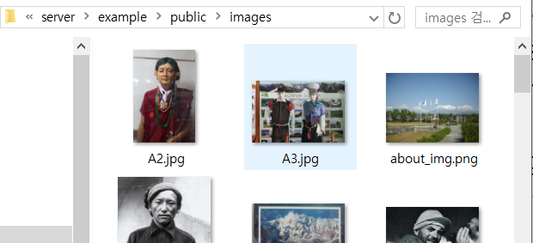
5.2 Creating API with Node.js and Express.js
Implementing museum API
Sample images provided by project team of Gandaki College are in Tutorial_source/Lab2/sample_img
Tutorial_source/Lab2/sample_img/img_sample.zip
Unzip img_sample.zip.
Move all images of img_sample into public folder.
Destination folder: C:\desktop\server\example\public/images

Slide 19
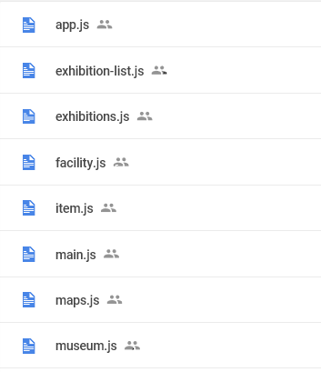
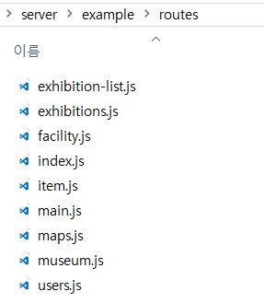
5.2 Creating API with Node.js and Express.js
Completing server
Use .js files in Tutorial_source/Lab2/routes for other APIs.
Replace app.js file of server with app.js in Tutorial_source/Lab2/routes folder and copy .js files and paste those in routes folder of server project.
app.js: C:\desktop\server\example
C:\desktop\server\example\routes
Run the server with command npm start

Slide 20
Summary
We implemented museum API.
We learned how to run Node.js server.
We learned how to load static image file from server.

Slide 21




Summary
Request
URI: http://localhost:3000/museum
API
Request URI (HTTP)
Response
app.js
app.use
museum.js
{
info_img: http://localhost:30 00/public/...
“info:…”
}
Response URI (HTTP)
Application

